Slide 1
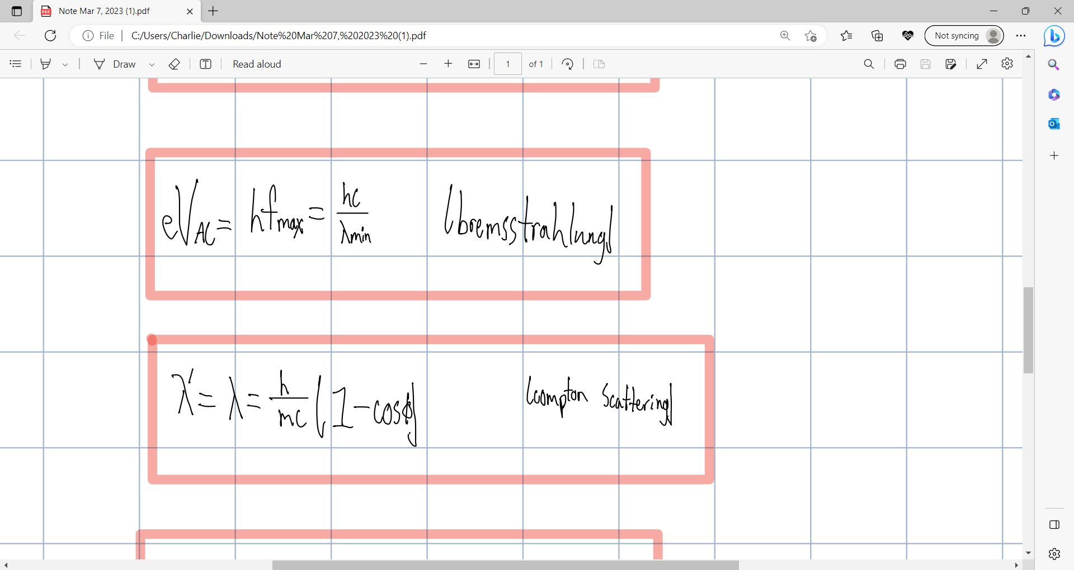
PHY CH 38

Slide 2
PHY CH 38

Slide 3
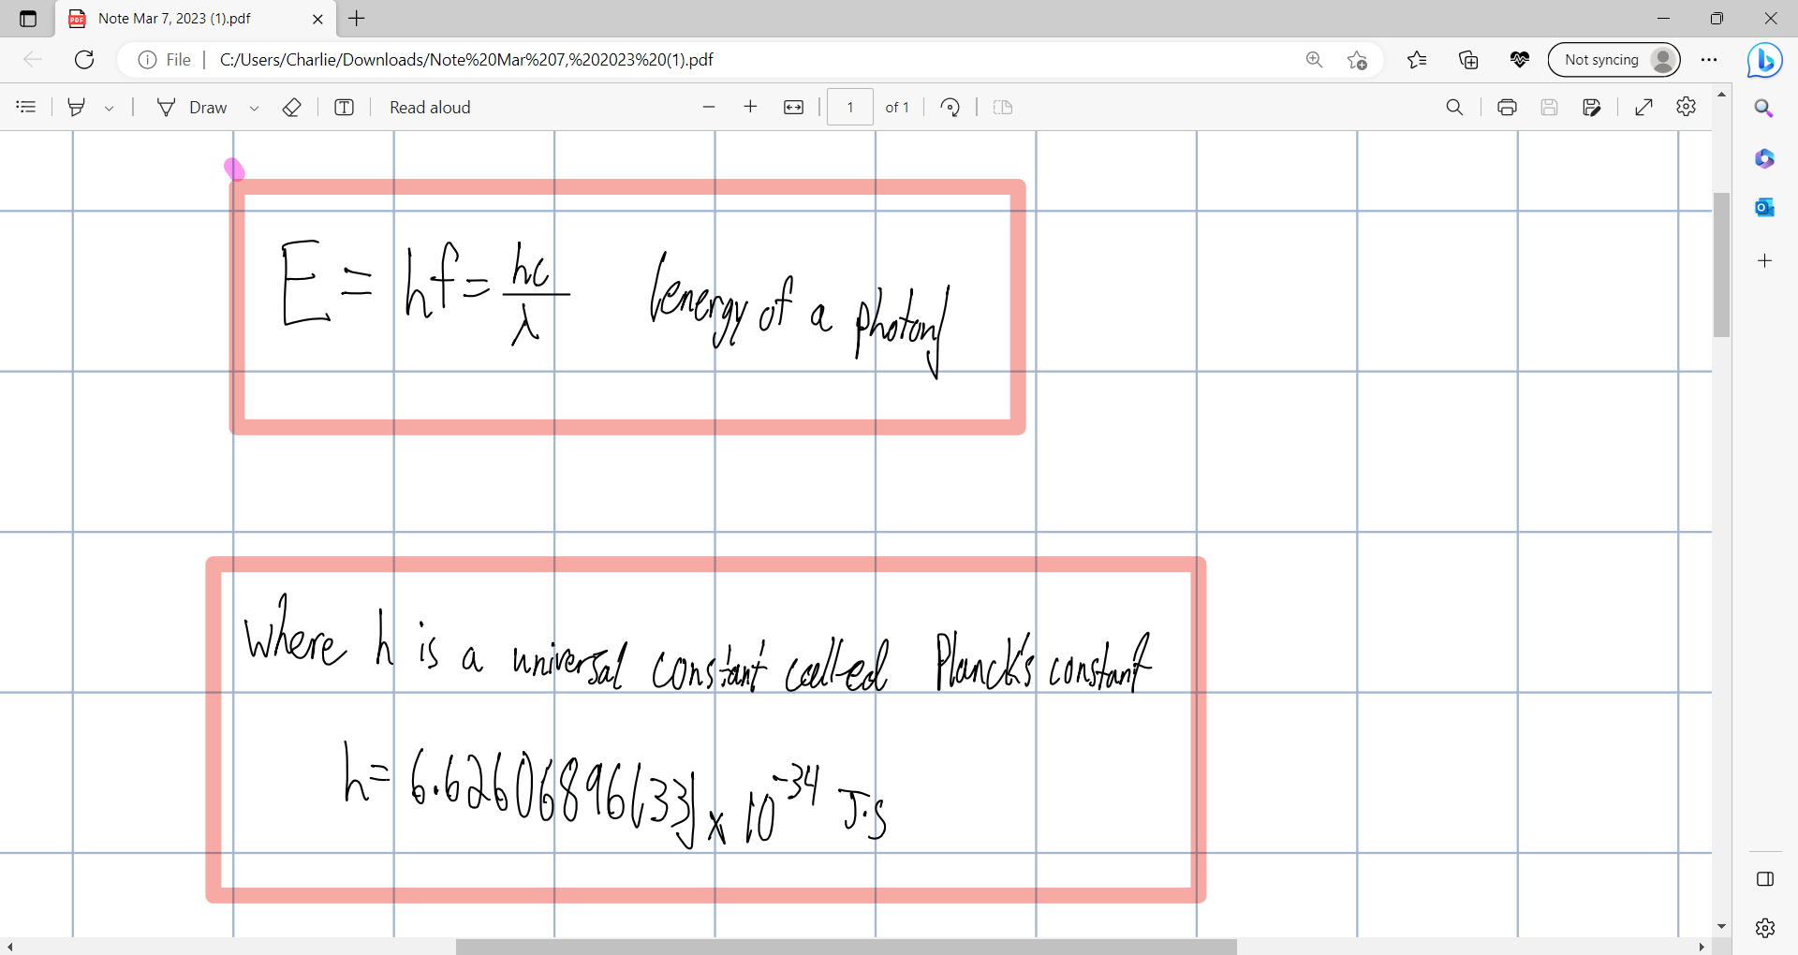

Slide 4
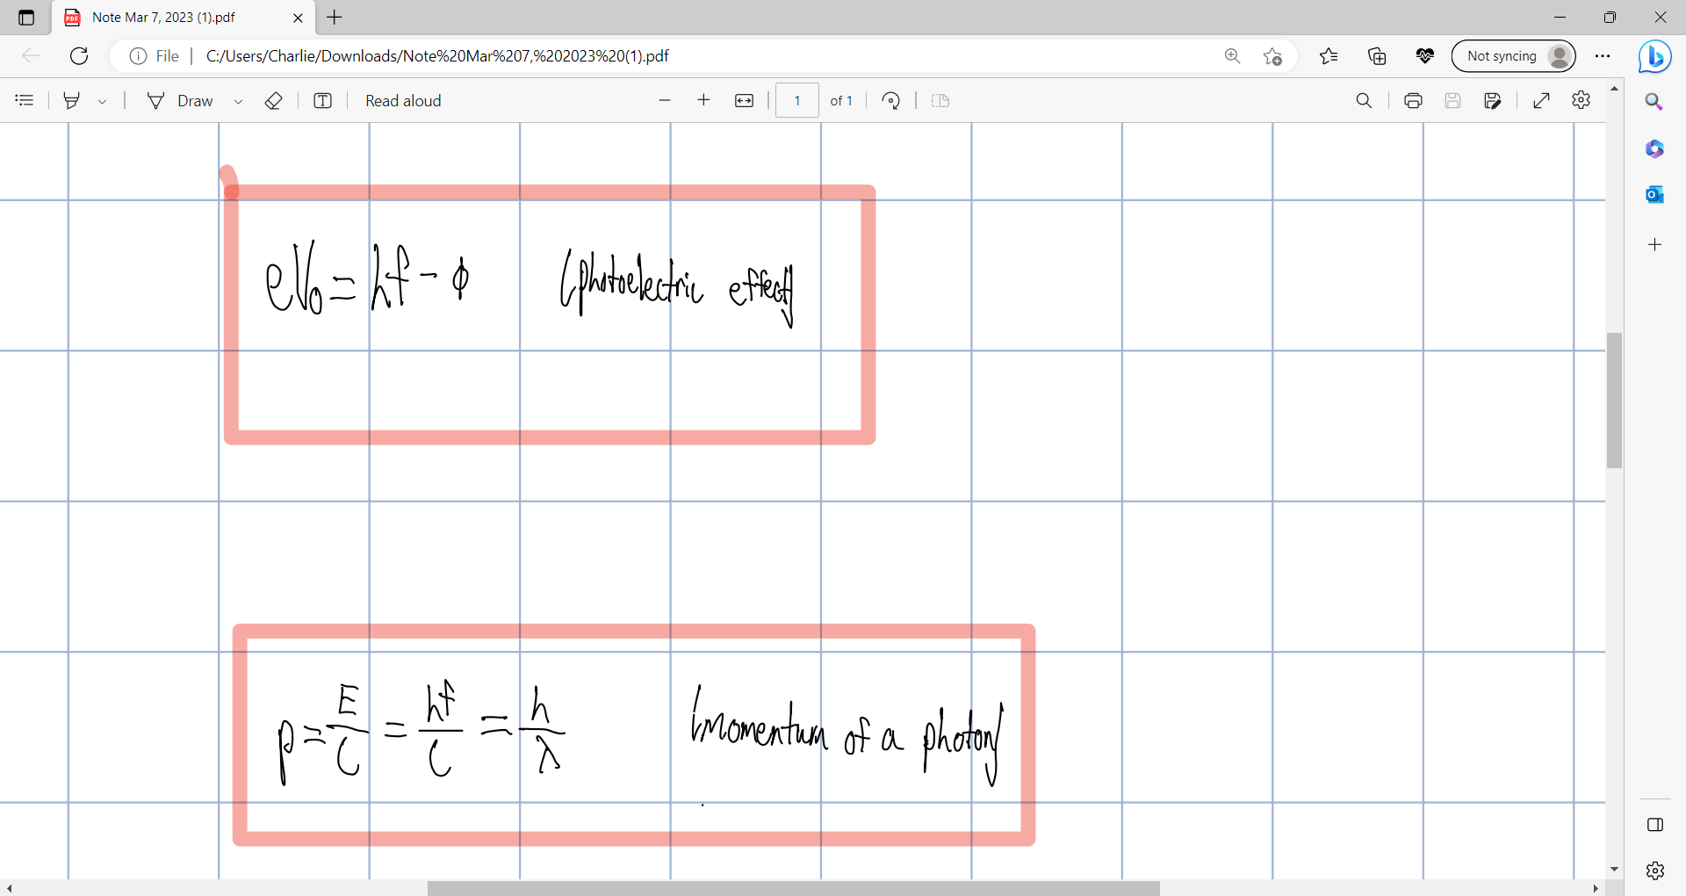

Slide 5
